Slide 1
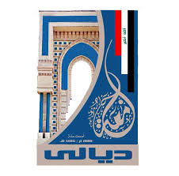
Electrical Circuit-I
8th Lecture

